Slide 1
PORTFOLIO PLANNING
INFT4000
Neo Lee, W0435748

Slide 2
Index
Description (Purpose)
Functionality
Colors
Storyboard
ERD
SAAD

Slide 3
Description

Slide 4
A pre-primary teacher needs to purchase a goods for children in a class and the teacher must submit a reconciliation every month about it. This project will produce an automation for this requirements through the application using electron.js.

Slide 5
Functionality

Slide 6
There are some functionality in this project
Report
Print
Purchase management
Append
Modify
Remove
Settings

Slide 7
Colors

Slide 8
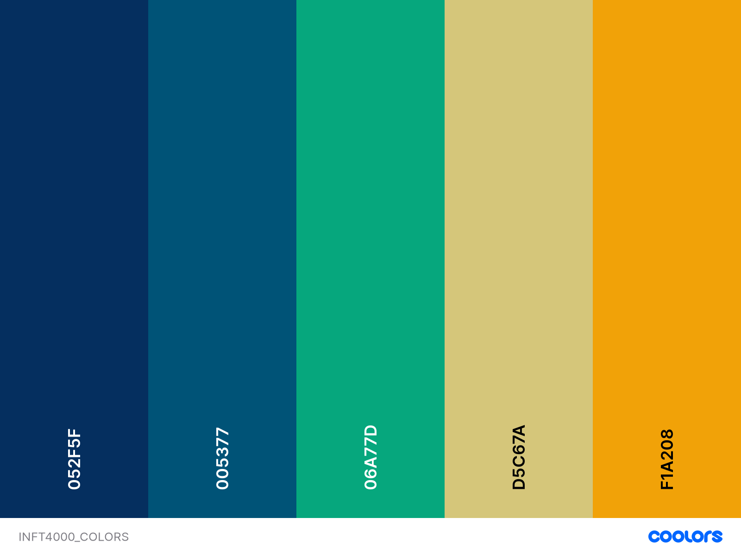
Buttons
In
MainPage
Add
/
Edit
Print
Report
Background
Delete

Slide 9
Storyboard

Slide 10
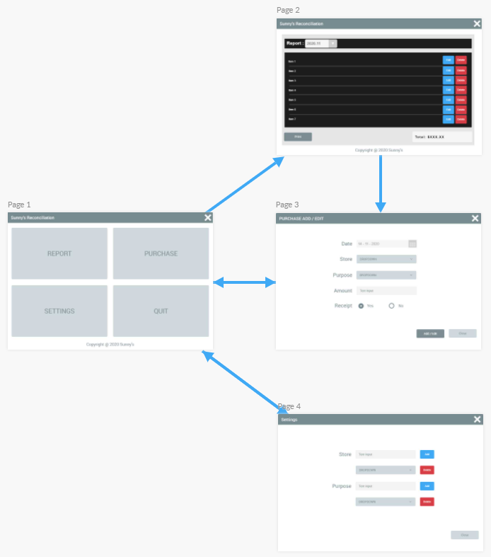
Pages Descriptions
Page1: Main Page
Page2: Report Page
- Display report
- Print report
- Edit or Delete items
Page3: Modify Page (Popup)
- Add items
- Edit items
Page4: Settings Page (Popup)
- Add/Delete Stores
- Add/Delete Purposes

Slide 11
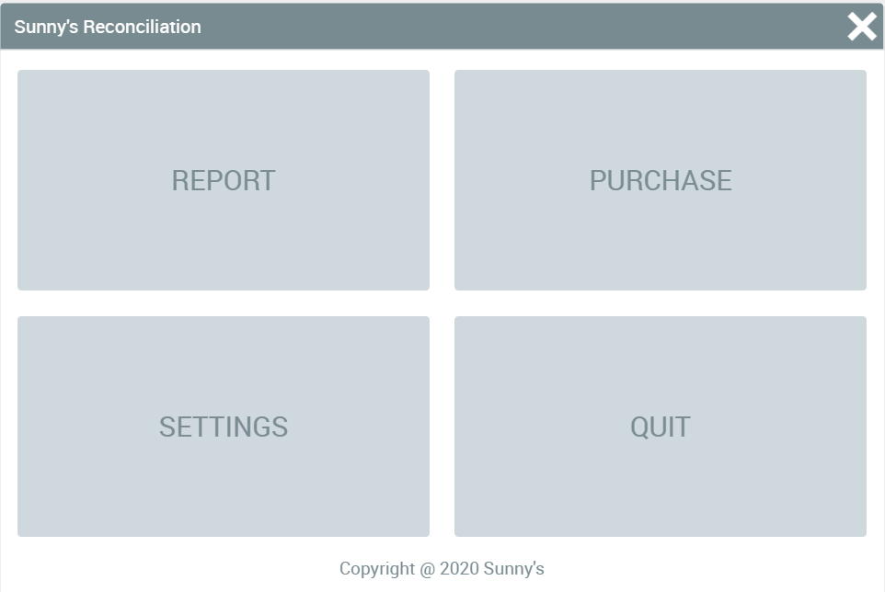
Main Page

Slide 12
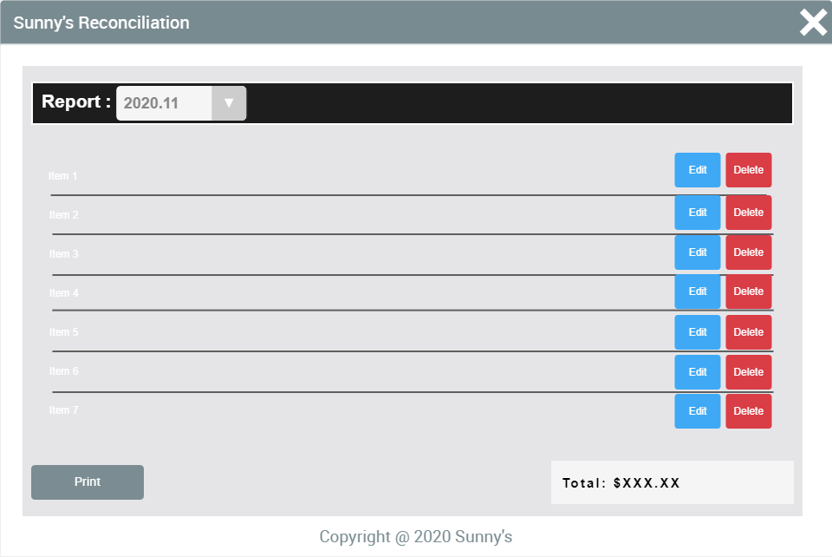
Report Page

Slide 13
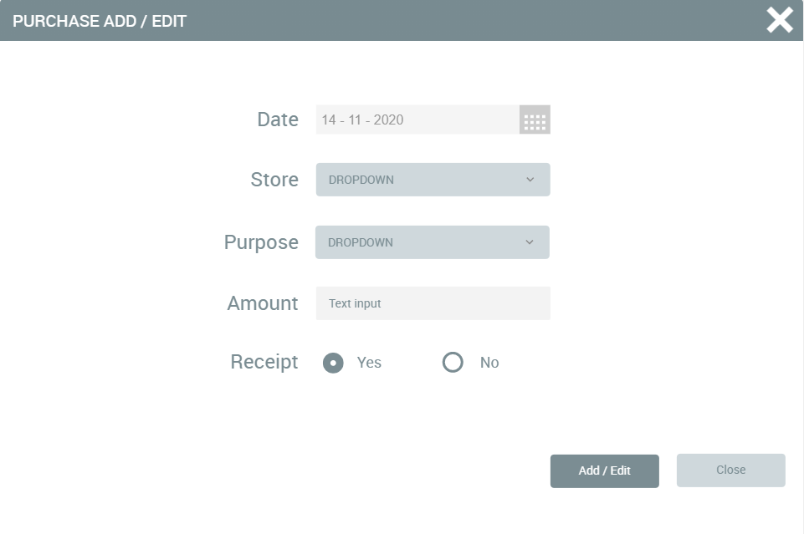
Modify Page

Slide 14
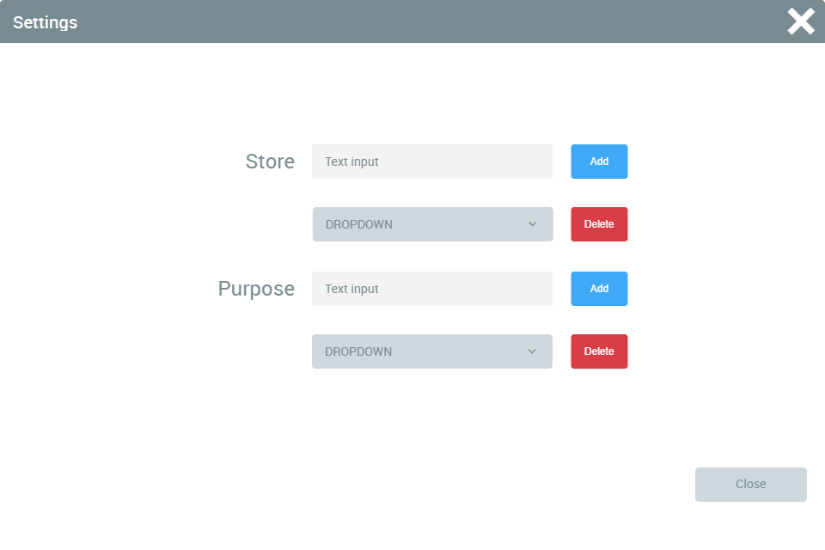
Settings Page

Slide 15
ERD

Slide 16
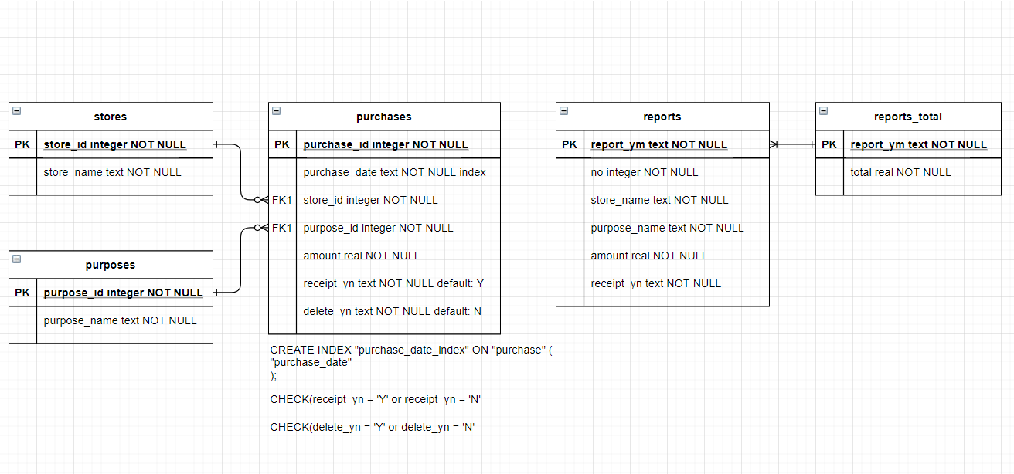

Slide 17
SAAD

